Slide 1
CSCI2520 Tutorial 5: Complexity Analysis
Pan Zhenyu
zypan24@cse.cuhk.edu.hk
Slide Ack: modified based on the slides from Li Hui

Slide 2
Outline
Big-O Notation
Big-O Formal Definition
Big-O Simplification Rules with Examples
Quick Mid-term Review

Slide 3
Big-O Notation
The relationship between the problem size N and the performance of an algorithm as N becomes large is called the computational complexity (or time complexity) of the algorithm.
The big-O notation is used to provide a quantitative insight as to how changes in the problem size N affect the algorithmic performance as N becomes large.

Slide 4
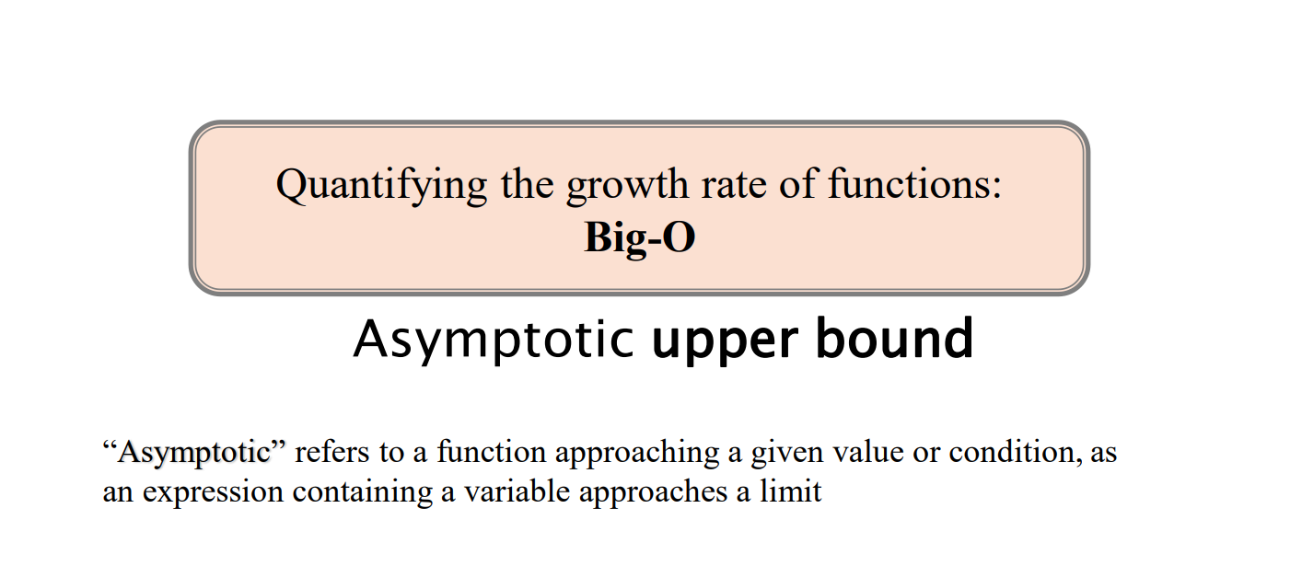
Big-O Notation

Slide 5
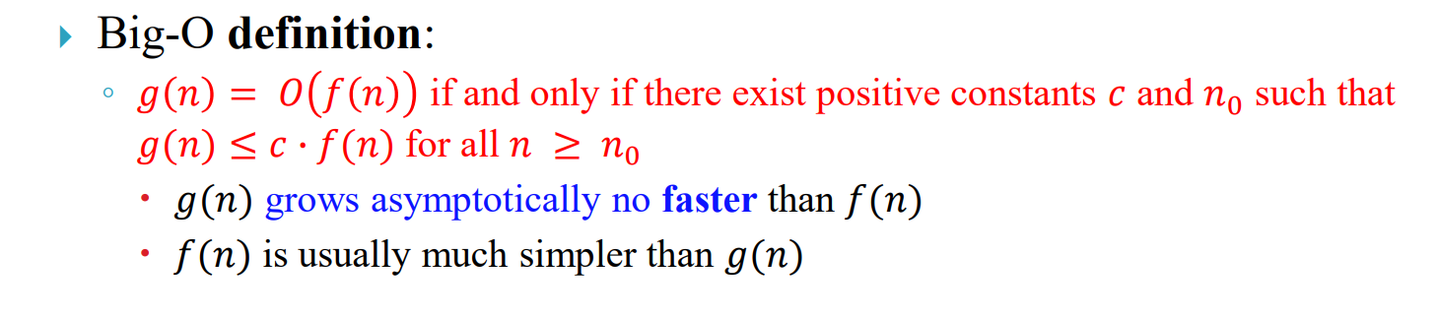
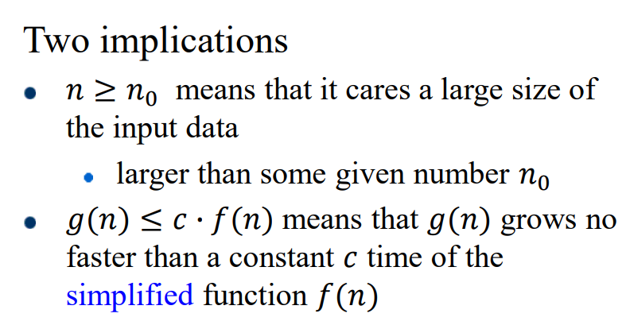
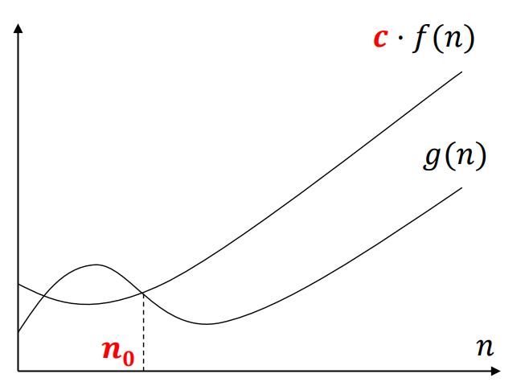
Big-O Formal Definition

Slide 6
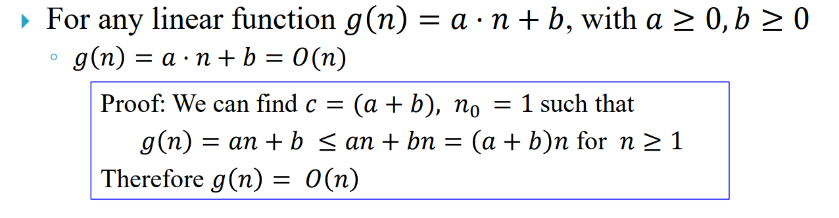
Example of Big-O

Slide 7
Example of Big-O

Slide 8

Exercise 1
Prove or disprove: 𝑔(𝑛) = 2𝑛 = 𝑂($n^{2}$)

Slide 9
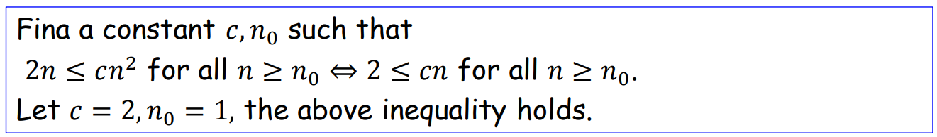
Exercise 1 Solution

Slide 10
Big-O Simplification Rules
Eliminate any term whose contribution to the total becomes insignificant as N becomes large.
When a formula involves a summation of several terms, the fastest growing term alone will control the running time of the algorithm for large N.
Example: N³ + 1000N² + N = O(N³)
Eliminate any constant factors.
What we want to capture in computational complexity is how changes in N affect the algorithmic performance.
Example: 0.1N³ = O(N³)

Slide 11
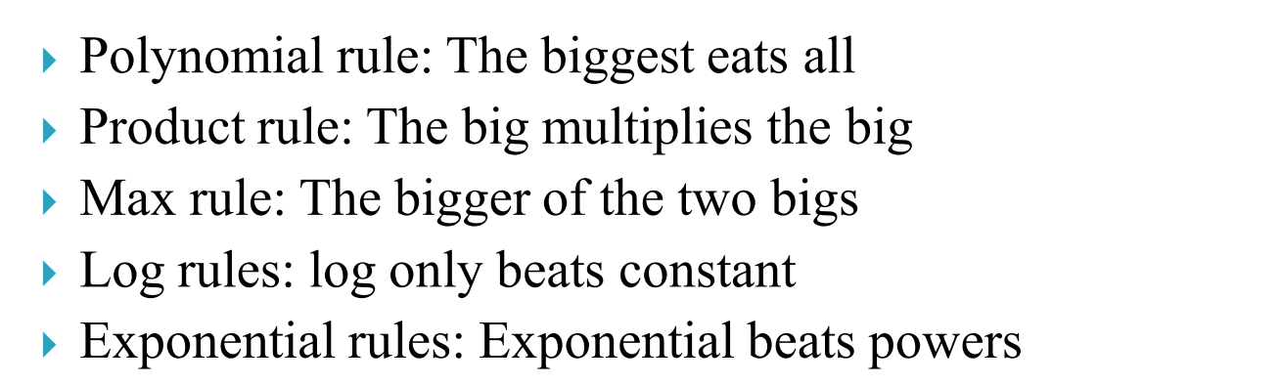
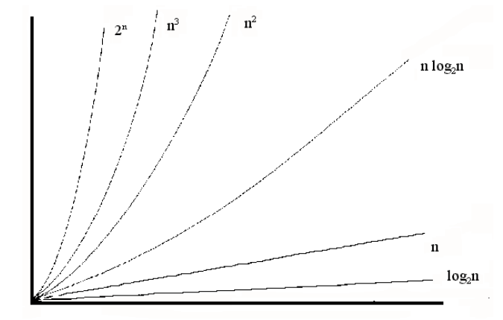
Big-O Simplification Rules

Slide 12
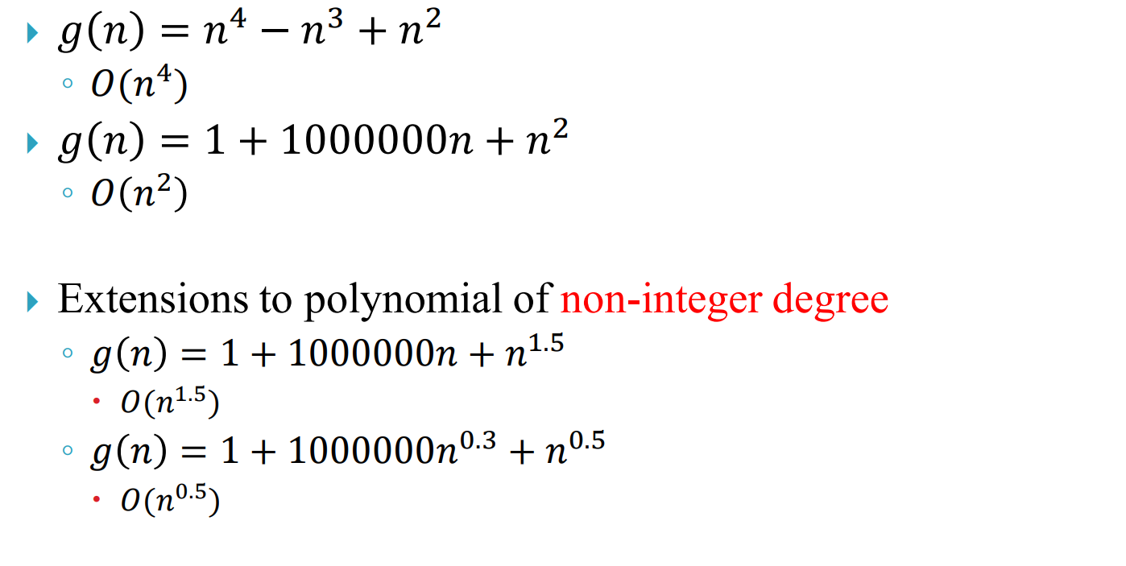
Polynomial rule: Examples

Slide 13
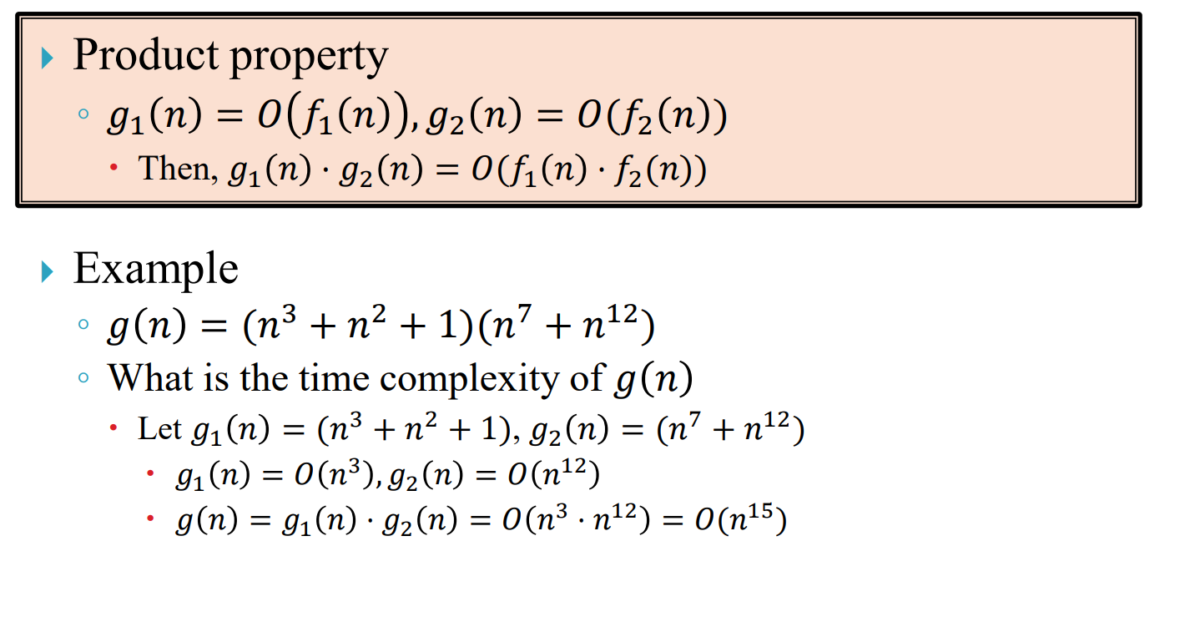
Product rule: The big multiplies the big

Slide 14
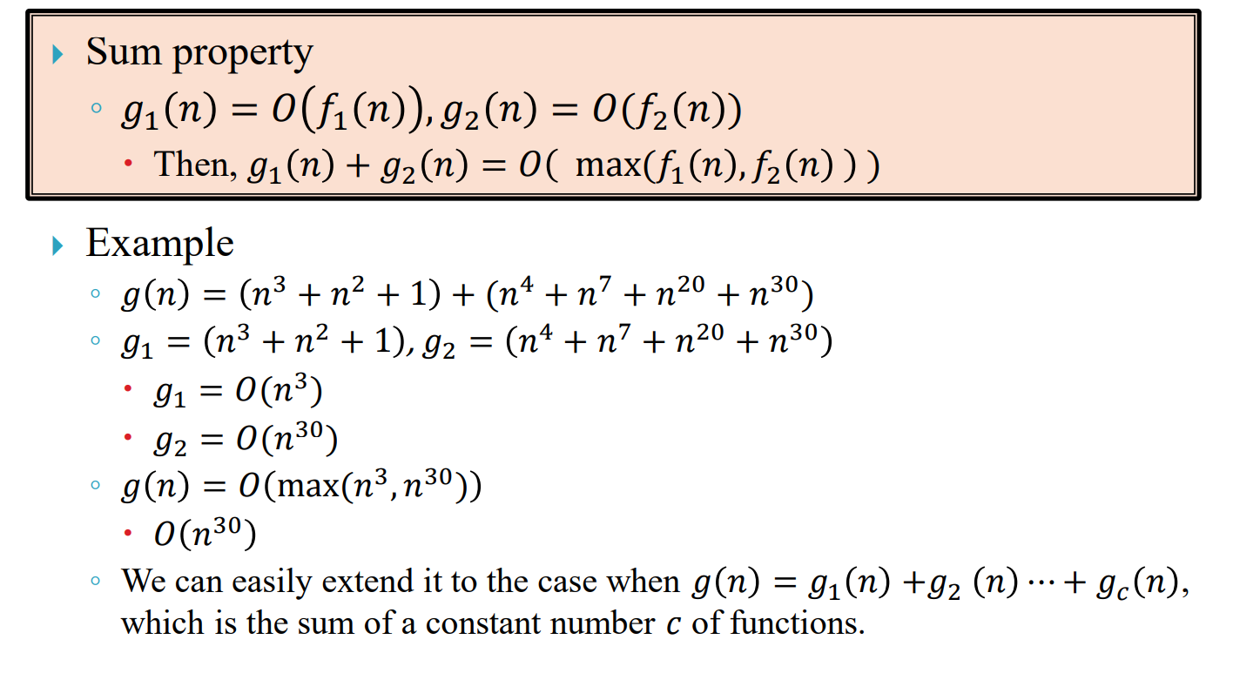
Max rule: The bigger of the two bigs

Slide 15
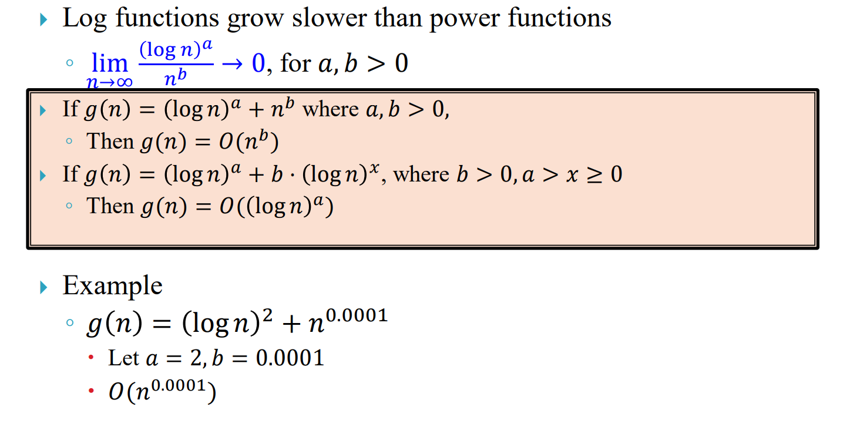
Log rules: log only beats constant

Slide 16
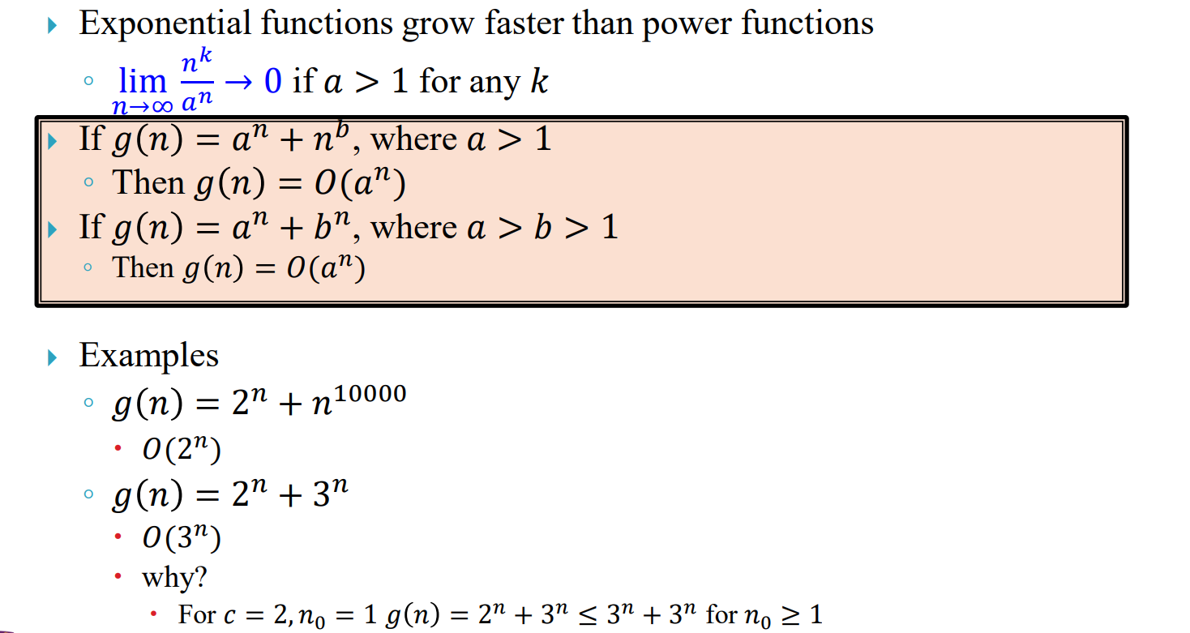
Exponential rules: Exponential beats powers

Slide 17
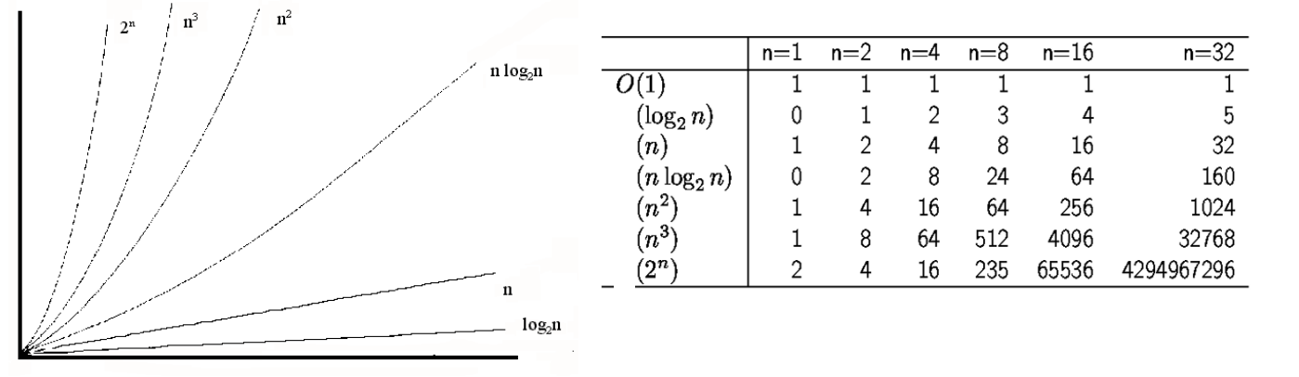
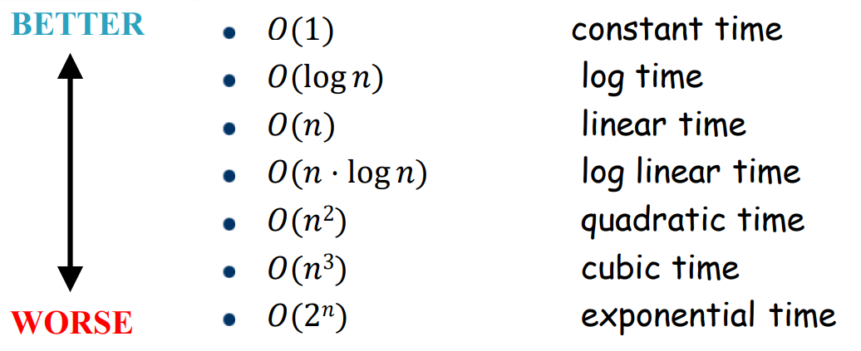
Common Big-O functions/classes

Slide 18
Exercise 2
Order the following functions by ascending order of growth rates.
2N^{1/2} + log N + 1
N + 5log N + 100
3N^{3/2} - 2N^{1/2}
2N² + 9Nlog N + 1
0.0001N³ + N

Slide 19
Exercise 2 Solution
Order the following functions by ascending order of growth rates.
2N^{1/2} + log N + 1 = O(N^{1/2})
N + 5log N + 100 = O(N)
3N^{3/2} - 2N^{1/2} = O(N^{3/2})
2N² + 9Nlog N + 1 = O(N²)
0.0001N³ + N = O(N³)

Slide 20
Quik Midterm Review

Slide 21
Summary
Big-O Notation
Big-O Formal Definition
Big-O Simplification Rules with Examples
Quick Mid-term Review

